Slide 1
Review of Ch33
Key words
Electromagnetic waves 电磁波
Transverse waves 横波
Antenna 天线
Wavefront 波前
Plane wave 平面波
Spectrum 谱线
Infrared红外线
Ultraviolet紫外线
The index of refraction折射率
Energy transport 能量传输
Poynting vector 坡印廷矢量
Intensity光强
Transmitted intensity 透射光强
Radiation pressure 光压
Total absorption 全吸收
Polarization （偏振）
Unpolarized 非偏振的
Polarizing filters 偏振片
Polarizer / Polaroid 偏振片/板
Reflection （反射） Refraction （折射）
Snell’s Law 斯涅尔定律（折射定律）
Chromatic dispersion 色散
Brewster Angle （布鲁斯特角）
Total internal reflection （全反射）
Critical angle （临界角）
Chromatic dispersion (色散）

Slide 2
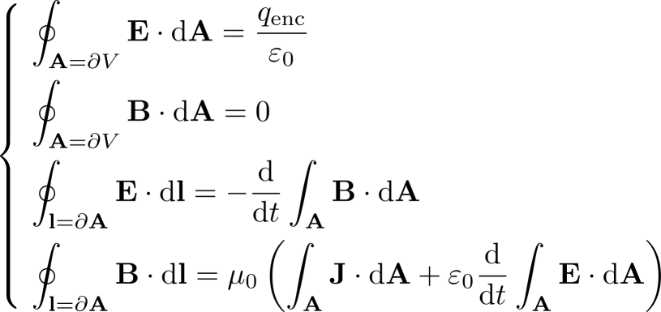
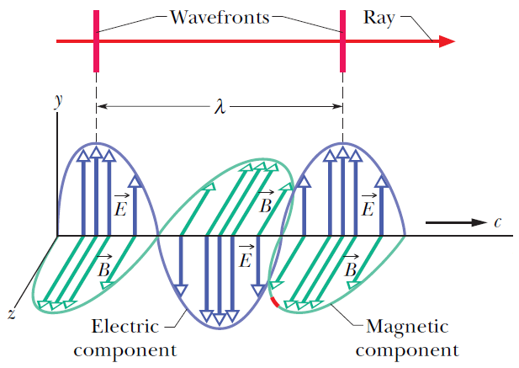
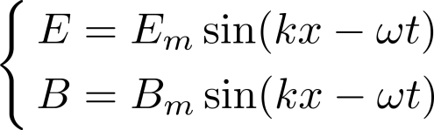
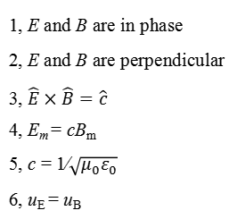
EM waves → Transverse waves
波面
光线
q = 0 & J = 0
1, E and B are in phase
2, E and B are perpendicular
3, $\hat{E}×\hat{B}=\hat{c}$
4, E_{m} = cB_{m}
5, c = 1∕$\sqrt{μ_{0}ε_{0}}$
6, u_{E} = u_{B}

Slide 3
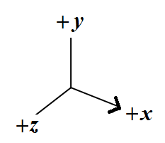
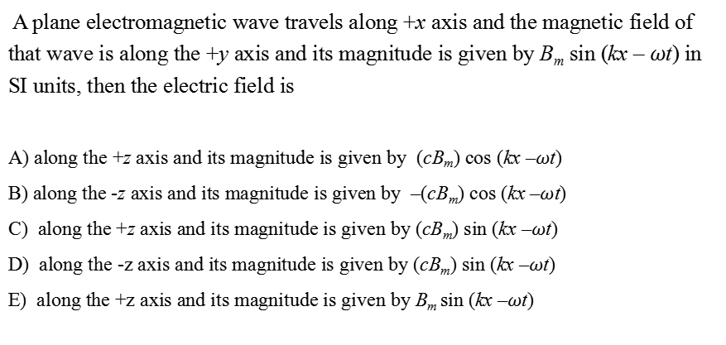
Quick question
A plane electromagnetic wave travels along +x axis and the magnetic field of that wave is along the +y axis and its magnitude is given by B_{m} sin (kx – $ω$t) in SI units, then the electric field is
A) along the +z axis and its magnitude is given by (cB_{m}) cos (kx –$ω$t)
B) along the -z axis and its magnitude is given by –(cB_{m}) cos (kx –$ω$t)
C) along the +z axis and its magnitude is given by (cB_{m}) sin (kx –$ω$t)
D) along the -z axis and its magnitude is given by (cB_{m}) sin (kx –$ω$t)
E) along the +z axis and its magnitude is given by B_{m} sin (kx –$ω$t)

Slide 4
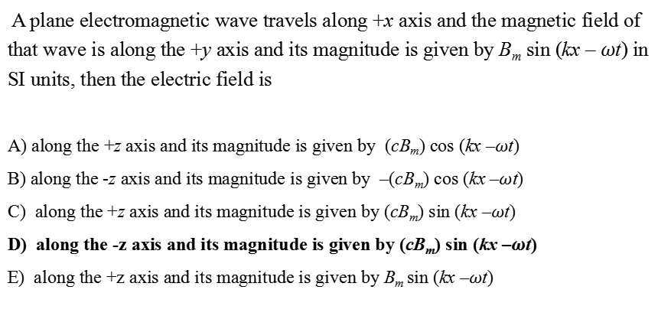
Quick question
A plane electromagnetic wave travels along +x axis and the magnetic field of that wave is along the +y axis and its magnitude is given by B_{m} sin (kx – $ω$t) in SI units, then the electric field is
A) along the +z axis and its magnitude is given by (cB_{m}) cos (kx –$ω$t)
B) along the -z axis and its magnitude is given by –(cB_{m}) cos (kx –$ω$t)
C) along the +z axis and its magnitude is given by (cB_{m}) sin (kx –$ω$t)
D) along the -z axis and its magnitude is given by (cB_{m}) sin (kx –$ω$t)
E) along the +z axis and its magnitude is given by B_{m} sin (kx –$ω$t)

Slide 5
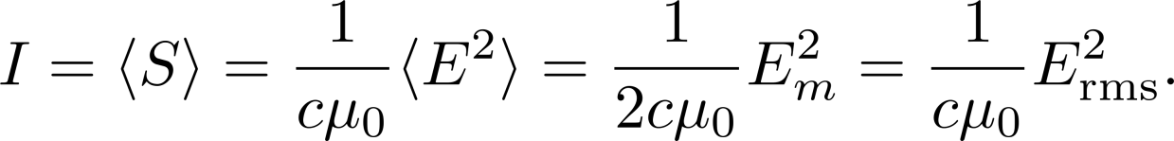



Poynting vector
Since E and B are changing, it is more meaningful to use its average value, which is called intensity I of the EM waves:
Change of intensity I with distance for a point source :

Slide 6
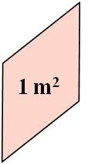

Radiation pressure
We can also understand light as particles, which we called photons (光子).
Photons have zero mass at rest, but they can carry energy and they have momentum:
Change of momentum
Therefore, light or EM waves can exert force / pressure on an object.
= pressure
c
c
c
momentum

Slide 7
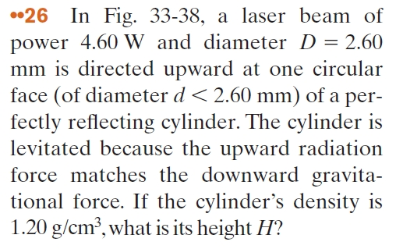
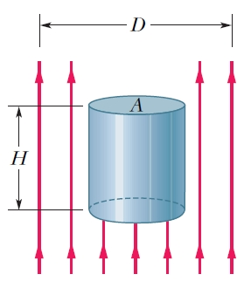
Problem 1

Slide 8
Problem 1
The mass of the cylinder is
where d is the diameter of the cylinder. Since it is in equilibrium
We solve for H:

Slide 9
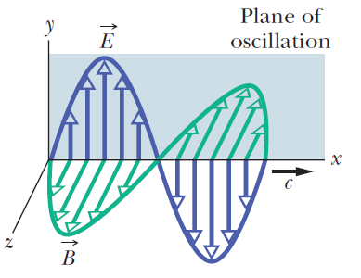
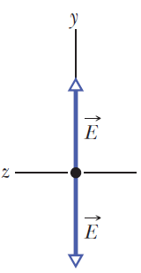
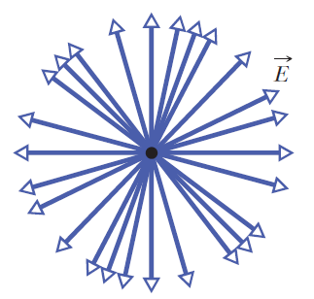
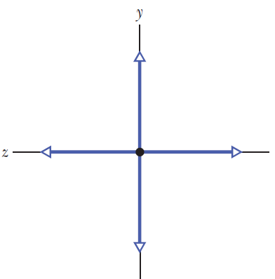
Polarization
We normally use the plane of E-field oscillation as the plane of oscillation of the wave
Linearly polarized light
Another view: a superposition of two perpendicular polarized components
Randomly polarized or unpolarized light (natural light)

Slide 10
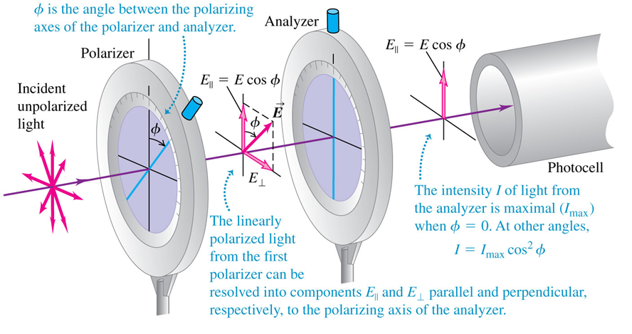
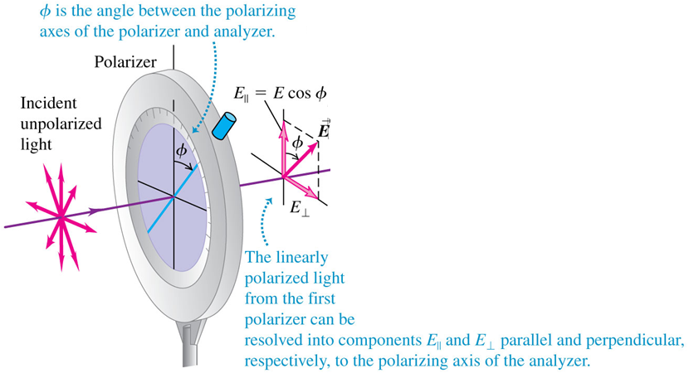




Polarization
$$I=I_{0 }$$
$$I1=I_{0 }/2$$
$$I2=I_{1 }cos2φ$$

Slide 11
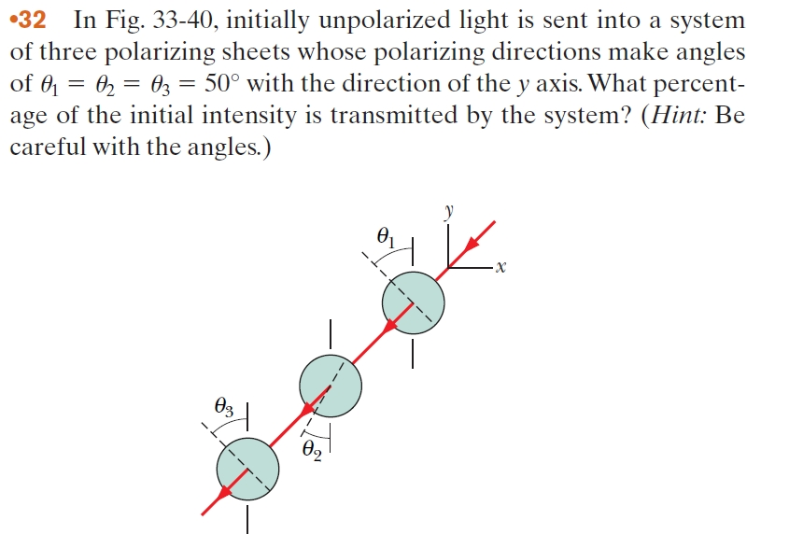
Problem 2

Slide 12

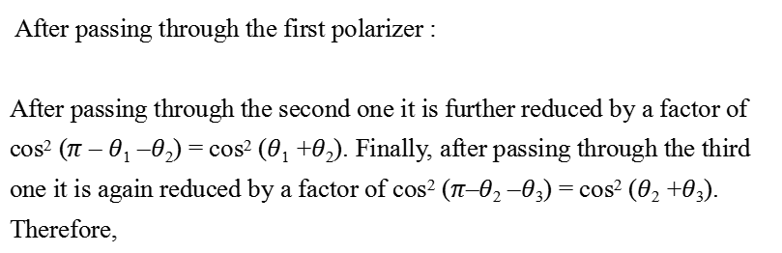
Problem 2
After passing through the first polarizer :
After passing through the second one it is further reduced by a factor of cos² ($π$ – $θ$₁ –$θ$₂) = cos² ($θ$₁ +$θ$₂). Finally, after passing through the third one it is again reduced by a factor of cos² ($π$–$θ$₂ –$θ$₃) = cos² ($θ$₂ +$θ$₃). Therefore,
$$I1=I0/2$$
Thus, 0.045% of the light’s initial intensity is transmitted.

Slide 13
Reflection (反射) and Refraction (折射)
Wave speeds differ in different media.
Index of refraction:
Incident ray
Normal
Reflected ray
Refracted ray
Normal
θ₁
θ₃
θ₂
Air
2: Air
Water
1: Water
Interface
θ₂
θ₃
θ₁
Refracted ray
Reflected ray
Incident ray
Critical angle:
Total internal reflection
Fermat's Principle: Light travels between two points along the path that requires the least time, as compared to other nearby paths

Slide 14
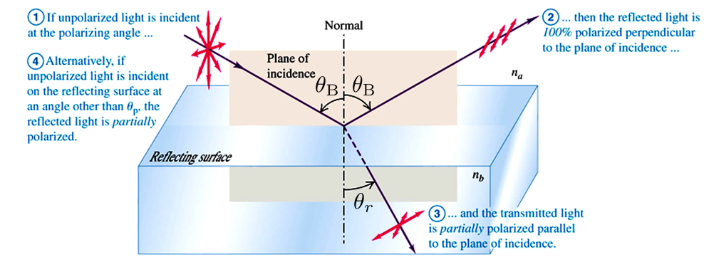


Polarization by reflection—Brewster’s angle
Brewster’s angle

Slide 15
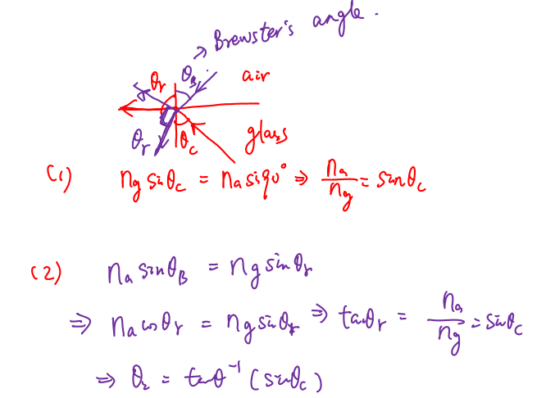
Problem 3
The critical angle for an air-glass interface is 29.6˚. When a light (nature light) ray in air is incident on the interface, the reflected ray can be fully absorbed by a polarizer. What is the angle of refraction (折射角) of that ray?
A) 23.9°
B) 25.7°
C) 25.1°
D) 24.5°
E) 26.3°

